Slide 1
Data Distribution
“Probability Distribution”

Slide 2
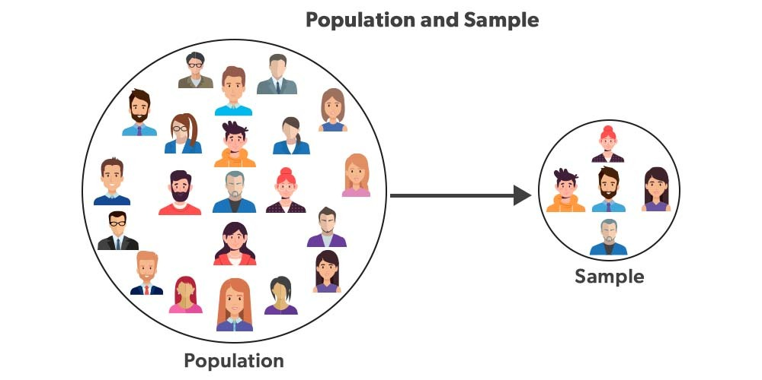

Slide 3
Statistical data distributions describe how data points are spread out across different values in a dataset.
Understanding these distributions helps in
analyzing and interpreting data
revealing patterns
trends
underlying structures.

Slide 4
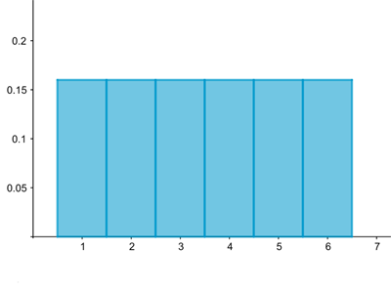
A histogram visualizing the distribution associated to rolling a die. The probability of rolling each of the six possible numbers is 1/6=0.166.

Slide 5
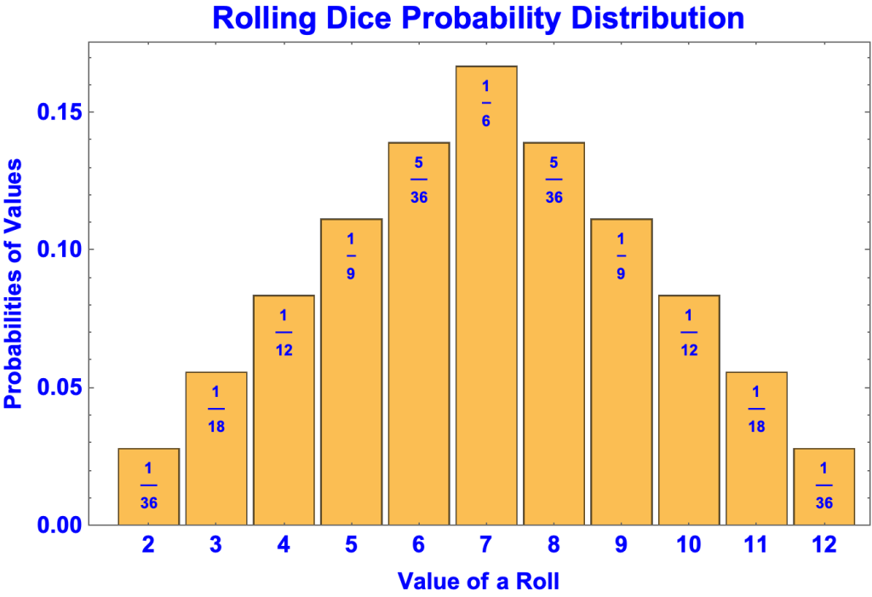

Slide 6
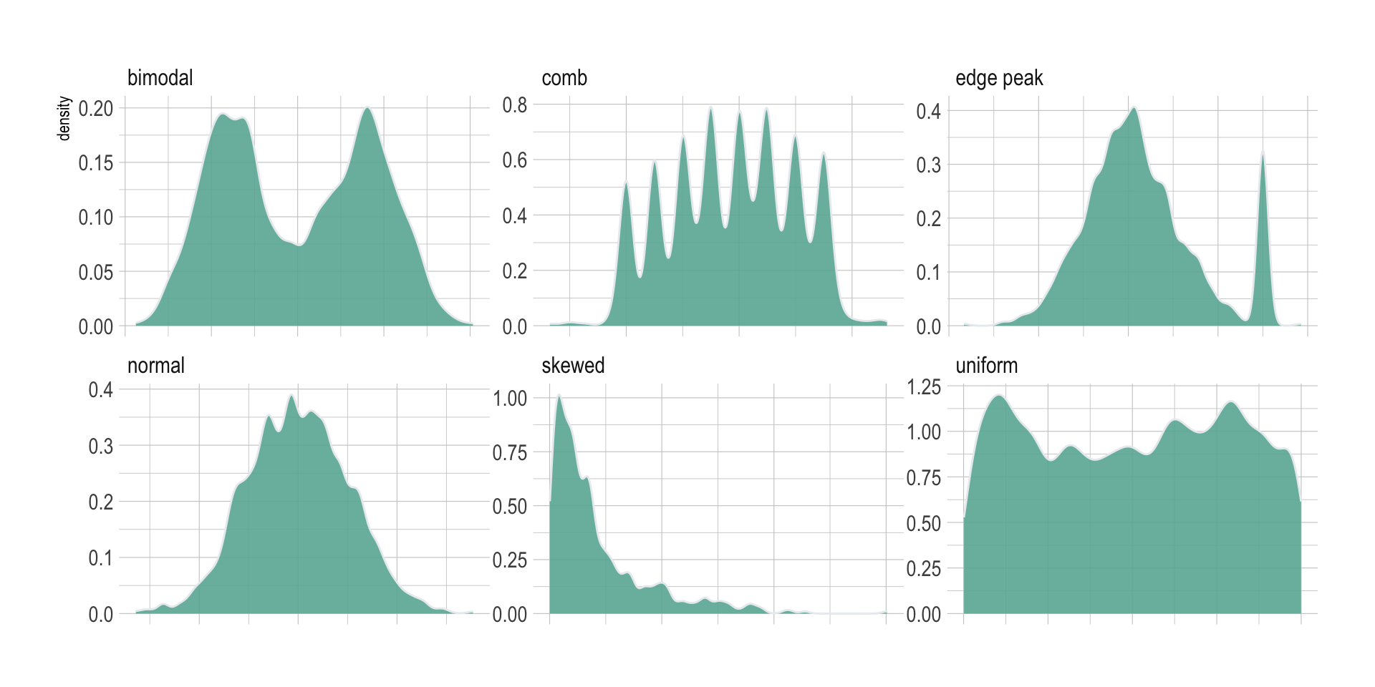

Slide 7
Data Visualizations
“Visualizing the distribution of our variables is an important step in exploring and analyzing data”

Slide 8


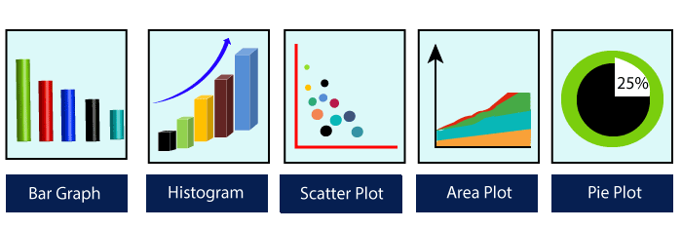
https://matplotlib.org/
John D. Hunter – Developed in 2003
(1968-2012)

Slide 9
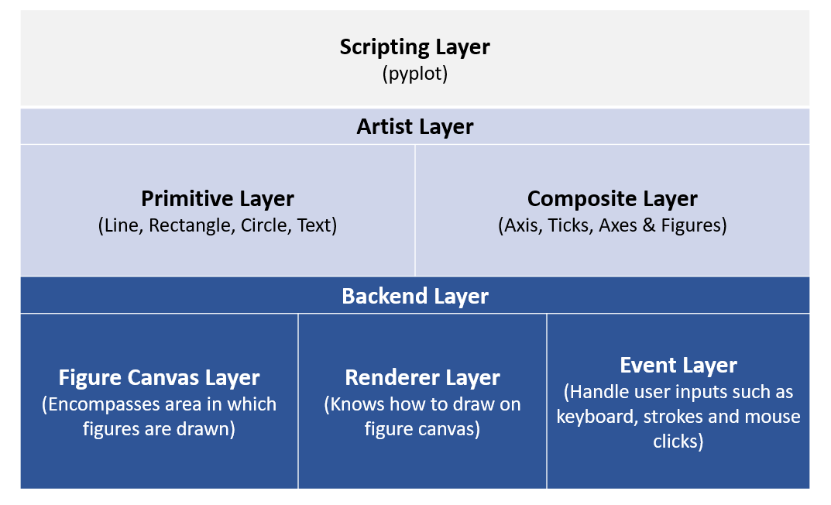

Slide 10
Matplotlib Architecture
Backend layer
The backend layer is the bottom layer of the figure, which consists of the implementation of the various functions that are necessary for plotting. There are three essential classes from the backend layer FigureCanvas(The surface on which the figure will be drawn), Renderer(The class that takes care of the drawing on the surface), and Event(It handle the mouse and keyboard events).
Artist Layer
The artist layer is the second layer in the architecture. It is responsible for the various plotting functions, like axis, which coordinates on how to use the renderer on the figure canvas.
Scripting layer
The scripting layer is the topmost layer on which most of our code will run. The methods in the scripting layer, almost automatically take care of the other layers, and all we need to care about is the current state (figure & subplot).

Slide 11
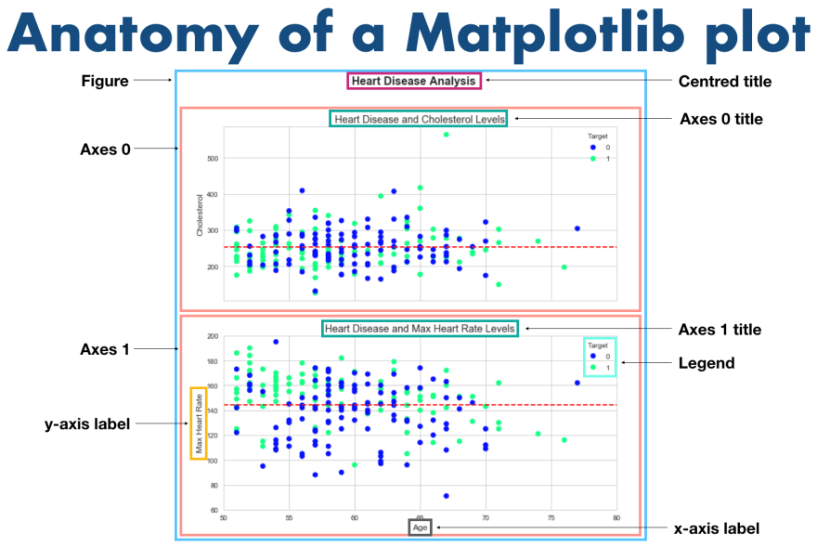

Slide 12
What is subplot()
The Matplotlib subplot() function is defined as to plot two or more plots in one figure. We can use this method to separate two graphs which plotted in the same axis Matplotlib supports all kinds of subplots, including 2x1 vertical, 2x1 horizontal, or a 2x2 grid.
It accepts the three arguments: they are nrows, ncols, and index. It denote the number of rows, number of columns and the index.

Slide 13
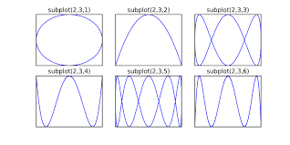

Slide 14
Boxplot

Slide 15
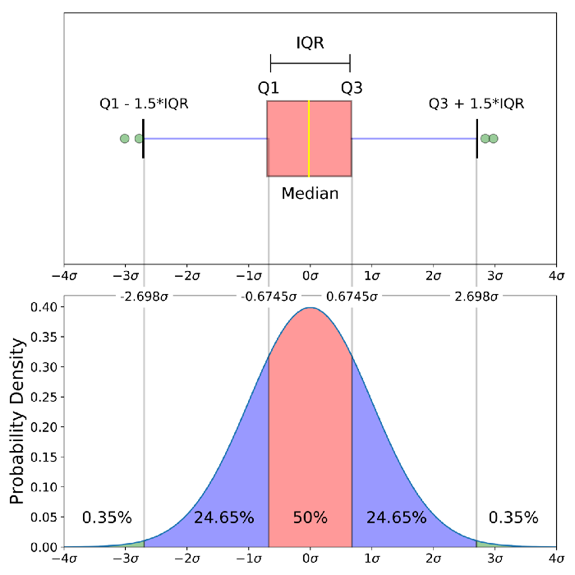

Slide 16
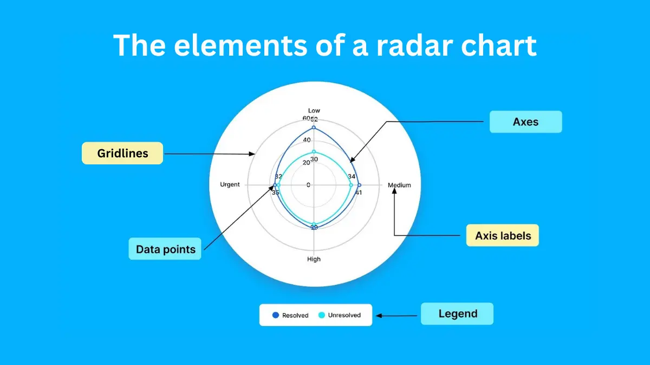

Slide 17
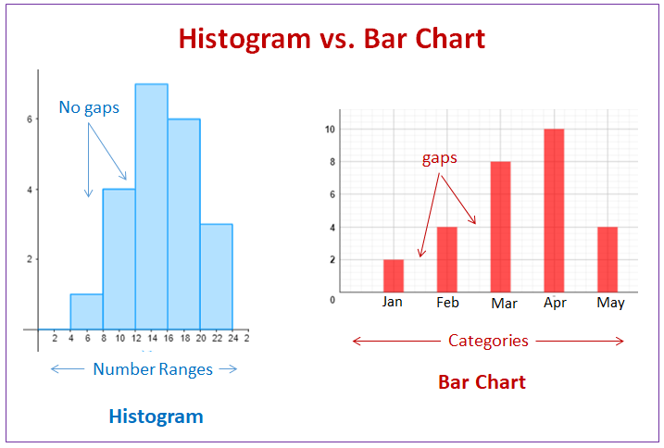

Slide 18
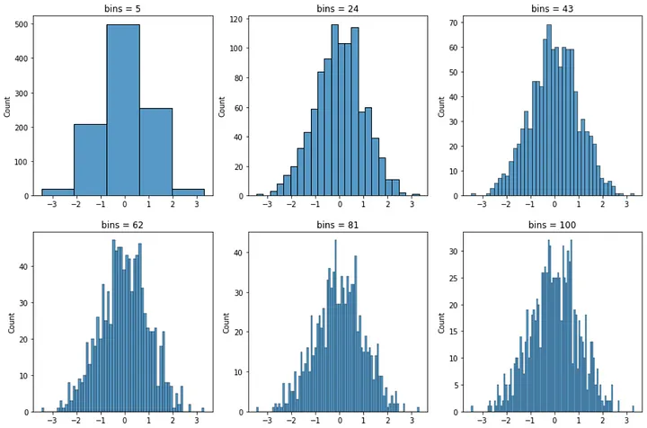

Slide 19
KDE Plot

Slide 20
Kernel Density Estimate
KDE Plot is used for visualizing the Probability Density of a continuous variable.
It depicts the probability density at different values in a continuous variable.
We can also plot a single graph for multiple samples which helps in more efficient data visualization.
It provides a smoothed representation of the underlying distribution of a dataset.

Slide 21
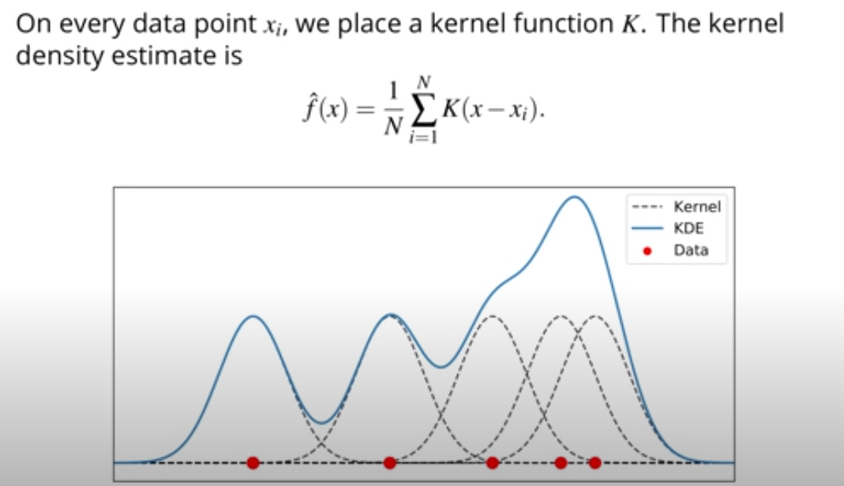

Slide 22
Point out the correct combination with regards to kind keyword for graph plotting.
a) ‘hist’ for histogram
b) ‘box’ for boxplot
c) ‘area’ for area plots
d) all of the mentioned

Slide 23
The plot method in matplotlib is __________
a) gplt.plot()
b) plt.plot()
c) plt.plotgraph()
d) none of the mentioned

Slide 24
You can create a scatter plot matrix using the __________ method
a) sca_matrix
b) scatter_matrix
c) DataFrame.plot
d) all of the mentioned

Slide 25
Which of the following graph can be used for simple summarization of data?
a) Scatterplot
b) Overlaying
c) Barplot
d) All of the mentioned

